Slide 1
Making Recommendations
Multifaceted Product Recommender by Walker McFarlan
Notes:
Hi! My name is Walker McFarlan and I am here to present my model based approach to item recommendation.

Slide 2
The Problem
Vendors are looking for interested consumers
Consumers are looking for products they will enjoy
The Solution
A well designed recommender capable of creating accurate predictions for each user’s unique profile.
Notes:
Recommenders solve two problems at once. Vendors are looking to connect their products to interested customers and the customers are looking for products worth their money. Building a robust recommender creates a positive symbiosis between these two groups and solves both problems.

Slide 3
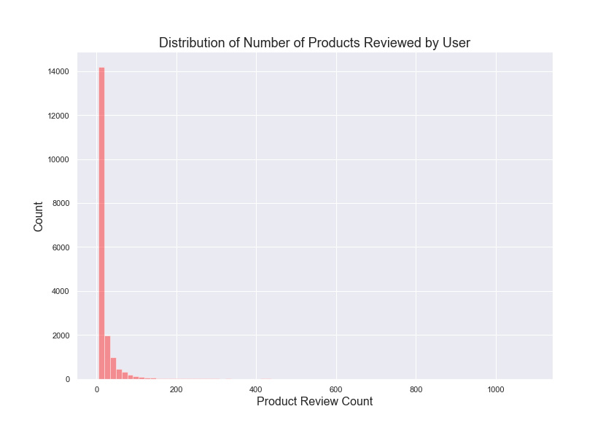
The Data
Amazon health product sales data collected from UCSD’s amazon repository from 2002 to 2014
346,355 unique purchases
from 38,609 unique users
18,534 unique products.
All products have been reviewed at least 5 times, all users have at least 5 reviews
Notes:
Amazon product data was collected from University of San Diego’s data repository. Within the health product data, there were a little less than 350,000 unique reviews for around 18,000 unique products. These products were reviewed by a around 38,000 unique users. All products in this dataset had at least 5 reviews, and all users had at least 5 reviews. When looking at the distribution of products with reviews, most products have around 20 reviews. When looking at users, most users have posted around 8 reviews. As sparsity was a large barrier for model training, the dataset was paired down to products with over 15 reviews, and users with more than 10 reviews.

Slide 4
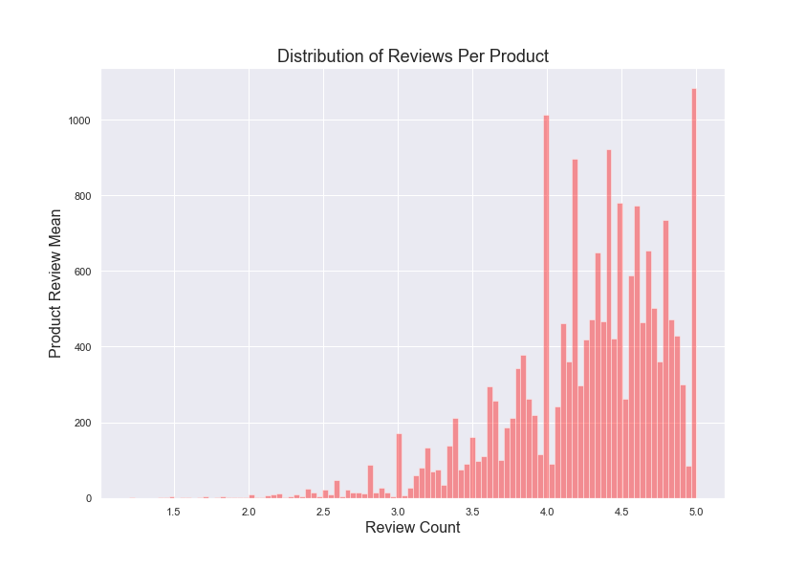
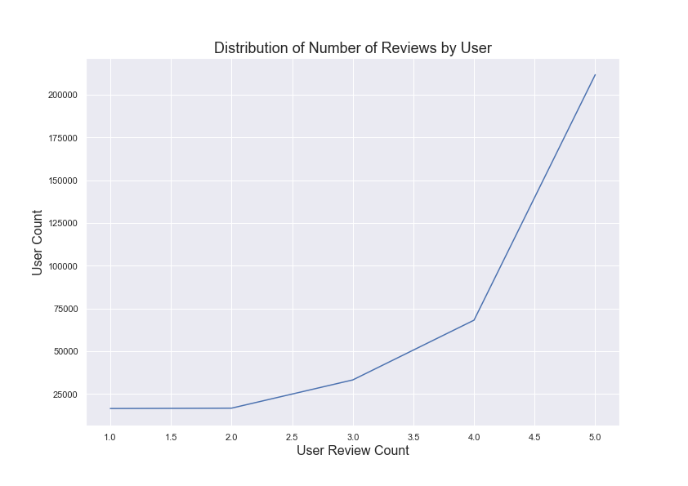
Distribution of Reviews
Most products are rated between 4 and 5
Most reviewers rate products highly
Notes:
When looking at the distribution of reviews, we can see most products score between 4 and 5, and most users rate items 4 or 5. This makes sense, as customers are not likely to buy products they know they won’t enjoy, and users are more motivated to post a review if they loved the product they purchased.

Slide 5
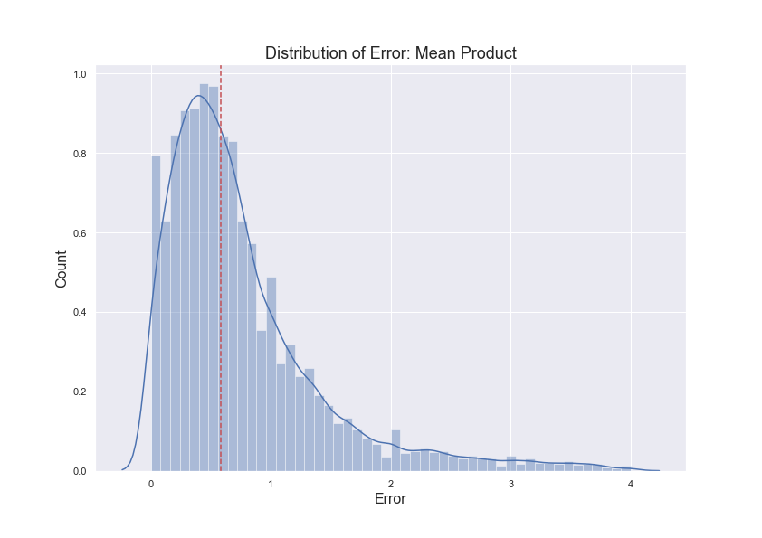
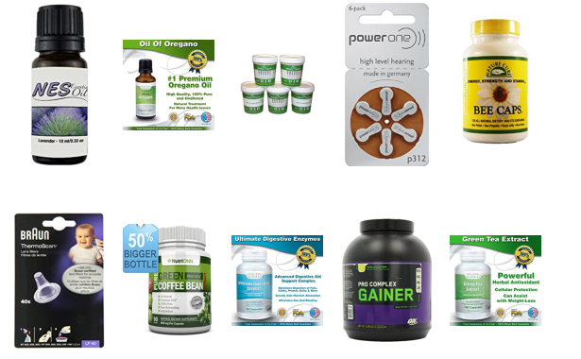
Baseline Recommender: Product Mean
Each product has their overall ratings averaged
Each user is recommended top 10 highest rated products
RMSE: 1.04
The Problem
Products with very few reviews that average out to a 5 are over represented
This approach can be easily manipulated scammers
Product Mean does not account for a users preference or any relationship between product to product
Notes:
As a baseline, I used the mean of each product as a predicted rating for each user. This somewhat naive approach gave a baseline RMSE of 1.04. Here on the right we can see the distribution of errors and the top 10 products following this baseline strategy. The issue with this approach is items one or two reviews are over represented. If a new product gets a 5 out of 5, it will be highly recommended. But a single review does not capture the quality of an item. Furthermore, this system would be easy to manipulate with bought reviews.

Slide 6
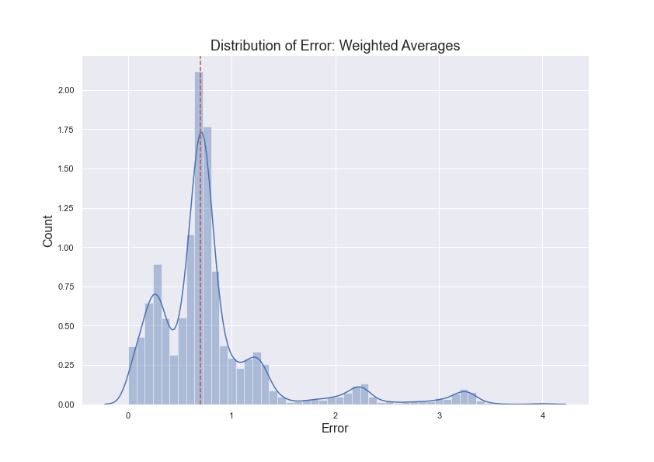
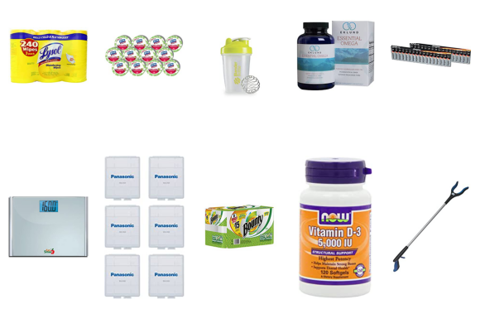
The Cold Start Problem
How do we recommend to new users without prior information about their shopping habits?
Cold Start Solution: Weighted Average
Each product has their overall score averaged
Products with less than 50 reviews are penalized
RMSE: 1.004
New users would have the top 10 currently highest rated products recommended to them
Notes:
A common problem with recommenders is the cold start. How do we make a recommendation to users we know nothing about? An approach less naive than our baseline is to recommending is using a weighted average that penalizes products with less than 50 reviews. This is the same approach IMDB uses to get a more accurate user ratings and avoid manipulation. This approach has a similar RMSE to the baseline, however it is able to make more informed product recommendations. Because this approach does not require any prior information on consumer purchases, I have selected it as my cold start. To the right we can see the distribution of errors as well as the current top 10 products that will be recommended to new users.

Slide 7
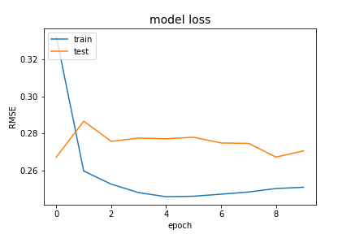
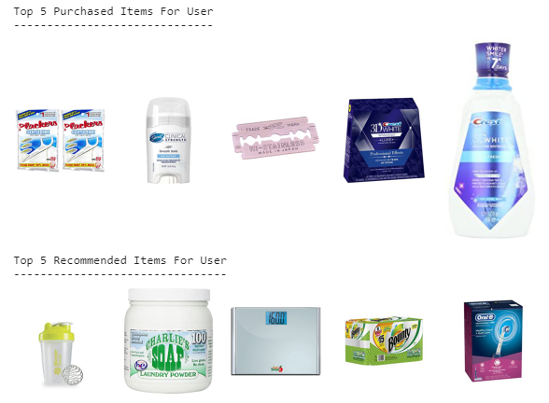
Final Predictive Model
After testing multiple models and approaches, an embedded neural network built on Keras architecture was selected
Using Collaborative Filtering, products and users are transformed inside separate embedding layers and trained to find similarities
This approach was more capable of dealing with non-linearity in the data and out performed traditional models
After tuning, an RMSE of 0.27 was achieved
Notes:
As a more robust predictive model, I have selected a neural network constructed with embedded layers. This model is based on explicit collaborative filtering. This neural network takes each unique user and each unique product and transforms them into unique vector spaces to find similarities. These embedded layers were multiplied together with two bias terms, one for the users, and one for the products. The final output was squished by a sigmoid to make the final prediction. Many other models and approaches were tested, as well as neural networks with more complicated architecture, however this model outperformed them. On the right we can see the train/test RMSE as well as my pipeline in action. For a selected user, you can see their top 5 reviewed purchases as well as the top 5 predicted items.

Slide 8
Future Work
Integrate other amazon product categories
Upscale to larger data
Find user data to integrate into modeling (age, sex, etc.)
Build to production
Notes:
In the future this model can be applied to many other categories of products and can be upscaled on larger datasets. In order to improve on modeling, user data such as age and sex can be integrated in. This kind of data would create more unique and informed groupings to make more advanced recommendations. And finally the pipeline can be built for live data.

Slide 9
Questions?
Notes:
Thank you for attending my presentation, are there any questions?

